Slide 1
EE 593 – Mobile Application Development
Final App Presentation - MotionGraphs
Andre Nunes Guerrero
Spring 2014
New Mexico State University

Slide 2
Motivation
Identify and prevent walking disorders and/or falling risks on subjects;
Use the application as scientific support for engaging in early treatment.
Motivated by interest and on-going research of Dr. de Leon, Dr. Kammerdiner (From the IE Department) and the ECE Graduate Student Andre Guerrero.
Notes:
Not only identify a fall but identify the increased chances on it happening, before it happens!
Physician Area! Go through a series of tests but they don’t provide a strong numerical result, like: If you have scored below 100 points, you need treatment.
Information is pretty much visually collected. Great margin to interpretation – No exact Index, nothing!
The application will provide and exact information/result based on pre-defined parameters.
<νυμβερ>

Slide 3
Why?
3 inputs for balance
  Visual;
  Vestibular (ears – 3D);
  Proprioceptive (joints – specially ankle).
Aging cause us to loose the “precision” of these “sensors”.
There is a threshold when we start falling!
Notes:
Aging cause us to loose the ability of collection information from these sensors and that affects our balancing skills. (specially loosing # 1 and 2).
Medical information provided by Dr. John G. Scarbraugh – College of Health and Social Services - NMSU
<νυμβερ>

Slide 4
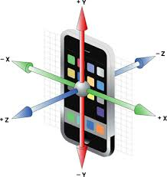
MotionGraphs – How it works?
Use the iPhone accelerometers to collect real-time motion information on 3-axys (G-force on x, y and z);
Log the information on a temporary text file;
Upload it to a FTP Server.

Slide 5
What’s Next?
The information can be latter used to reconstruct the gate pattern for that individual and compared to pre-defined parameters.
The hope is that this comparison will be able to identify common patterns among faller people and allow them to engage in early treatment.

Slide 6
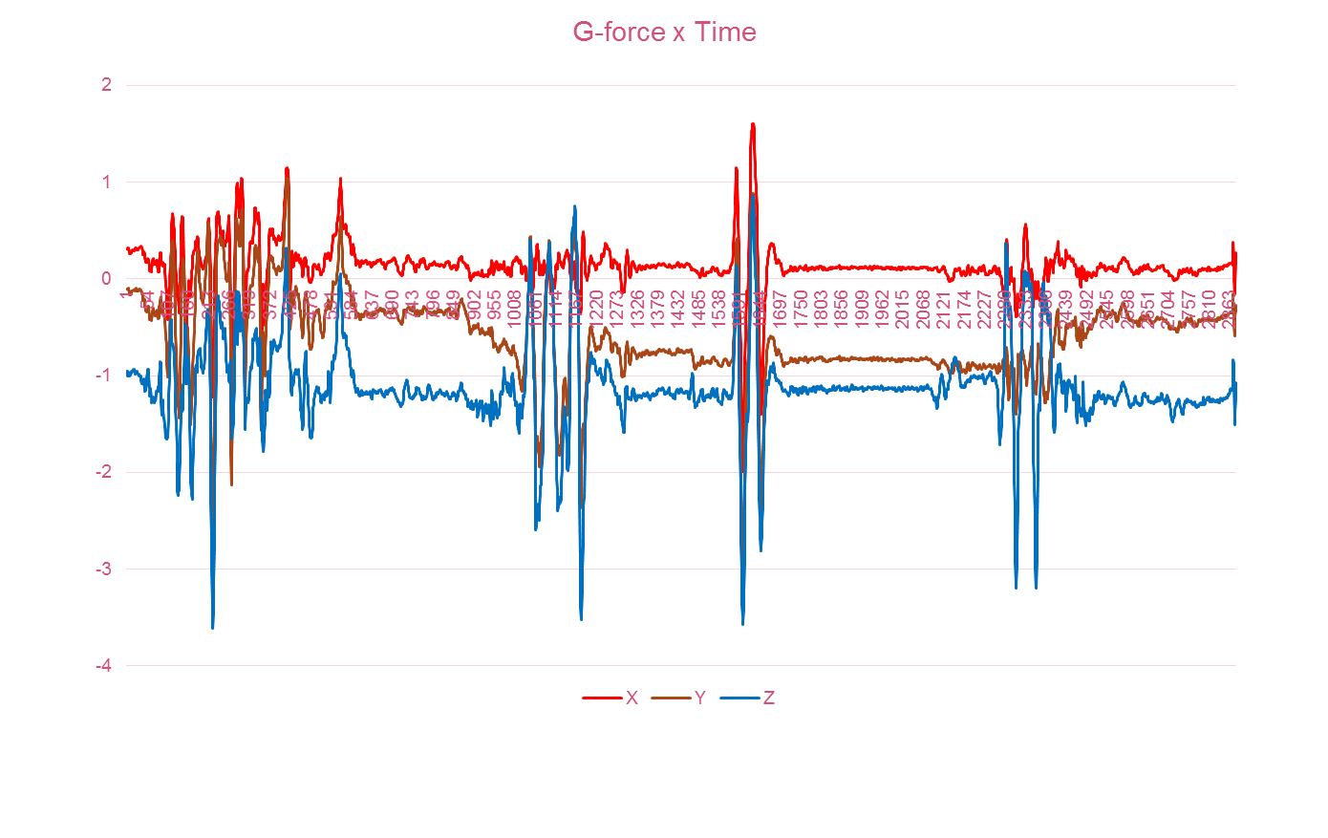
What’s Next?
Notes:
Almost 4 G’s on Axis Z – There might be a problem!
<νυμβερ>

Slide 7
Demo!
App demonstration.

Slide 8
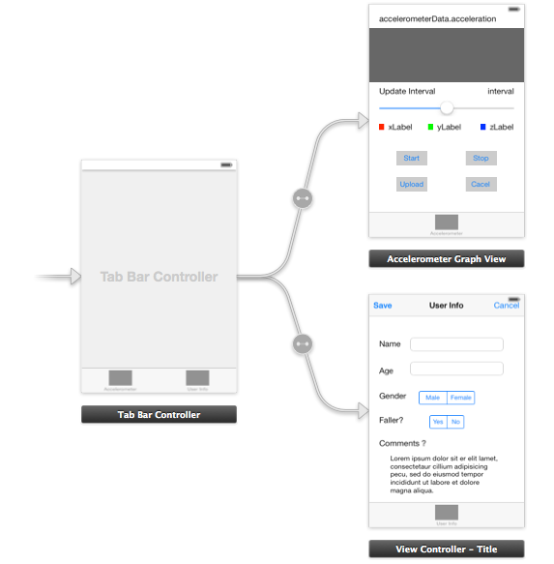
Coding - Storyboard
Notes:
APLAccelerometerGraphViewController - View controller to manage display of output from the accelerometer.
APLUserInfoViewController.m - View controller to manage the collection of user personal information.
APLGraphView.m - Displays a graph of output. This class uses Core Animation techniques to avoid needing to render the entire graph every update.
<νυμβερ>

Slide 9
Coding - Classes
APLAccelerometerGraphViewController
APLUserInfoViewController
APLGraphView
*Based on Apple Sample Code!
Notes:
APLAccelerometerGraphViewController - View controller to manage display of output from the accelerometer.
APLUserInfoViewController.m - View controller to manage the collection of user personal information.
APLGraphView.m - Displays a graph of output. This class uses Core Animation techniques to avoid needing to render the entire graph every update.
<νυμβερ>

Slide 10
Issues
Application relies on FTP Connection – can be exploited
No Apple support for SFTP connection – needs to work with third-party libraries.
Latency for saving information to file - difficult to go over 100Hz.
Notes:
APLAccelerometerGraphViewController - View controller to manage display of output from the accelerometer.
APLUserInfoViewController.m - View controller to manage the collection of user personal information.
APLGraphView.m - Displays a graph of output. This class uses Core Animation techniques to avoid needing to render the entire graph every update.
<νυμβερ>

Slide 11
Thank you!
New Mexico State University

